Slide 1


Java ee
(ADVANCE JAVA)
Lecture-52

Slide 2
Today’s Agenda
Jquery Effects
Slide , Hide , Show and Fade
Applying Animation
Accessing HTML input controls

Slide 3
JQUERY EFFECTS
Effects in Jquery are animated behaviour shown by HTML elements.
The main jquery actions to be used for this are
Show
Hide
Fade
etc

Slide 4
HIDE AND SHOW
As the name implies, hide( ) and show( ) are actions which can be used to make HTML elements invisible or visible.
Syntax:
$(“selector”).show ( );
$(“selector”).hide ( );

Slide 5
EXAMPLE
Example:
$("#hide").click(function(){ $(“#div1”).hide(); });
$("#show").click(function(){ $(“#div1”).show(); });

Slide 6
HIDE AND SHOW
Both hide() and show() can take the two optional parameters: speed and callback.
Syntax:
$(selector).hide(speed,callback)
$(selector).show(speed,callback)
The speed parameter specifies the speed of the hiding/showing, and can take the following values: "slow", "fast", "normal", or milliseconds
The callback parameter specifies the function to be executed after the hide (or show) function completes

Slide 7
USING CALLBACK
As mentioned earlier a callback function is executed after the current animation is completely over.
Syntax:
$(selector).hide(speed,function( )
{
//code
});

Slide 8
USING TOGGLE
The jQuery toggle() method toggles the visibility of HTML elements using the show() or hide() methods.
Shown elements are hidden and hidden elements are shown.
Syntax:
$(selector).toggle(speed,callback)

Slide 9
APPLYING FADING
The fadeIn() method gradually changes the opacity, for selected elements, from hidden to visible (fading effect).
The fadeOut() method gradually changes the opacity, for selected elements, from visible to hidden (fading effect).

Slide 10
APPLYING FADING
The fadeTo() method gradually changes the opacity, for selected elements, to a specified opacity (fading effect).
Syntax:
$(selector).fadeTo(speed,opacity,callback)
The opacity factor specifies the opacity to fade to and must be a number between 0.00 and 1.00

Slide 11
APPLYING SLIDING
The slideDown() method animates the height of the matched elements. This causes lower parts of the page to slide down, making way for the revealed items.
The slideUp() method animates the height of the matched elements. This causes lower parts of the page to slide up, hiding away the revealed items.

Slide 12
APPLYING SLIDING
The slideToggle() method causes toggle effect i.e elements which are up will slide down and vice versa

Slide 13
APPLYING ANIMATION
The animate() method performs a custom animation of a set of CSS properties.
This method changes an element from one state to another with CSS styles. The CSS property value is changed gradually, to create an animated effect.
But only numeric numeric values can be animated (like "margin:30px"). String values cannot be animated (like "background-color:red").
Syntax:
$(selector).animate({styles},speed,callback)

Slide 14
HTML MANIPULATION
jQuery contains powerful methods (functions) for HTML elements and attributes.
These methods can not only access HTML controls but also manipulate their contents

Slide 15
CHANGING HTML CONTENT
The html() method changes the contents (innerHTML) of matching HTML elements.
Syntax
$(selector).html(content)
Example:
$("p").html(“<b>Sachin</b>");

Slide 16
APPENDING HTML CONTENT
The append() method appends content to the inside of matching HTML elements.
Syntax:
$(selector).append(content)

Slide 17
ADDING HTML CONTENT
The after() method adds content after the matching HTML elements.
Syntax:
$(selector).after(content)

Slide 18
OBTAINING TEXT
The val() method sets/gets input fields content
Syntax:
$(selector).val( )
$(selector).val(“some text” )

Slide 19
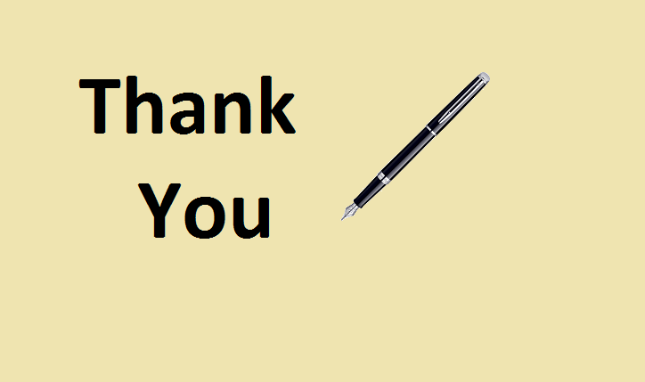
End Of Lecture
For any queries mail us @: scalive4u@gmail.com
Call us @ : 0755-4271659, 7879165533
Agenda for Next Lecture:
PROJECT DISCUSSION

